Slide 1
Project report
*Introduction*: - Provide an overview of the project, including its objectives and scope. - Mention the importance of efficient maintenance in a health hub's medical claim system.
2. *Project Scope*: - Define the specific areas or components of the medical claim system that require maintenance. - Describe the integration of Zoho Books into the system.
3. *Maintenance Plan*: - Detail the maintenance activities, such as software updates, bug fixes, and regular system checks.

Slide 2
Preparation and maintance of zoho book for health hub medical clinic
HealthHub Medical Clinic, a healthcare facility, relies on Zoho Books to manage patient billing and invoicing. They can track medical service fees, manage insurance payments, and generate statements for patients. Zoho Books helps them maintain financial transparency and ensures efficient billing process.

Slide 3
PROBLEM DEFENITION &DESIGN THINKING
Its created method of preparation of accounting profit and loss account balance sheet and GST calculation is completed.
In recent day’s new technologies alloted .here we use zoho book as a tool for creating profit and loss account ,balance sheet and GST report.
Empathy map
Ideation & brainstorming map

Slide 4
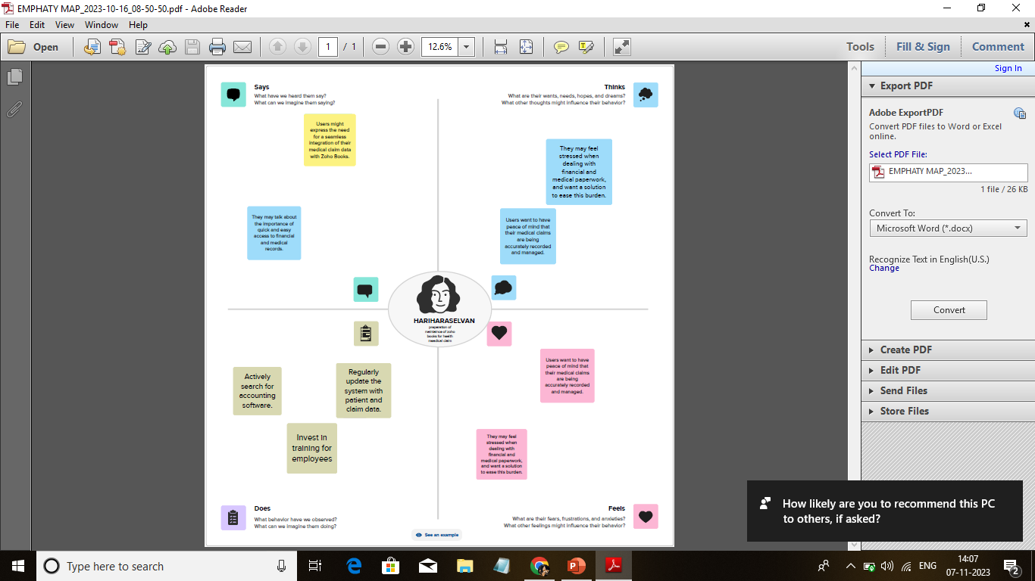
EMPATHY MAP

Slide 5
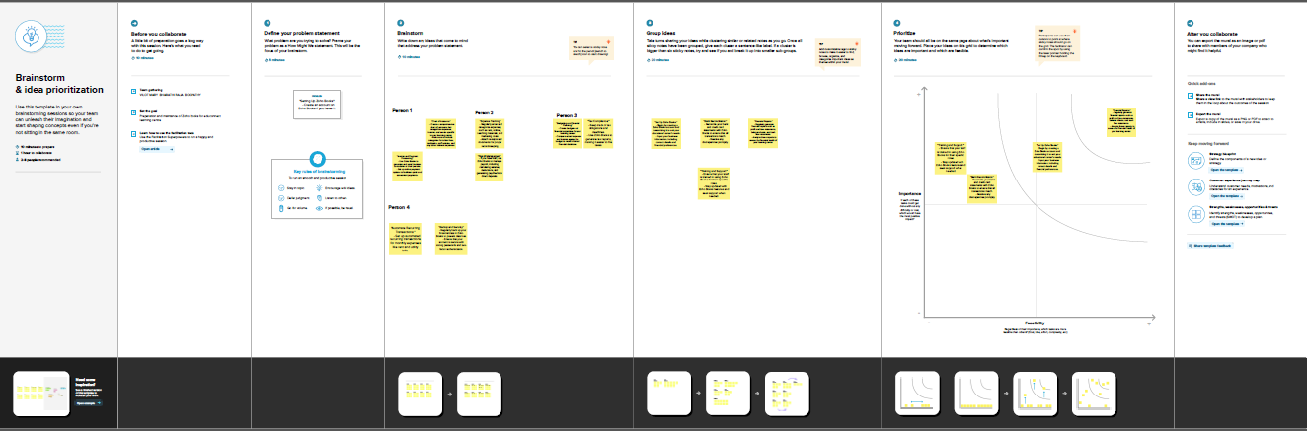
RESULT Output:
Company name creation.

Slide 6
We have to create our Company Name And other Details From Below Zohobooks
2. Item Creation:
We have to create items, Such as
➢ Item names
➢ Units
➢ HSN/SAC
➢ Selling info/Purchase info
➢ Tax Rate

Slide 7
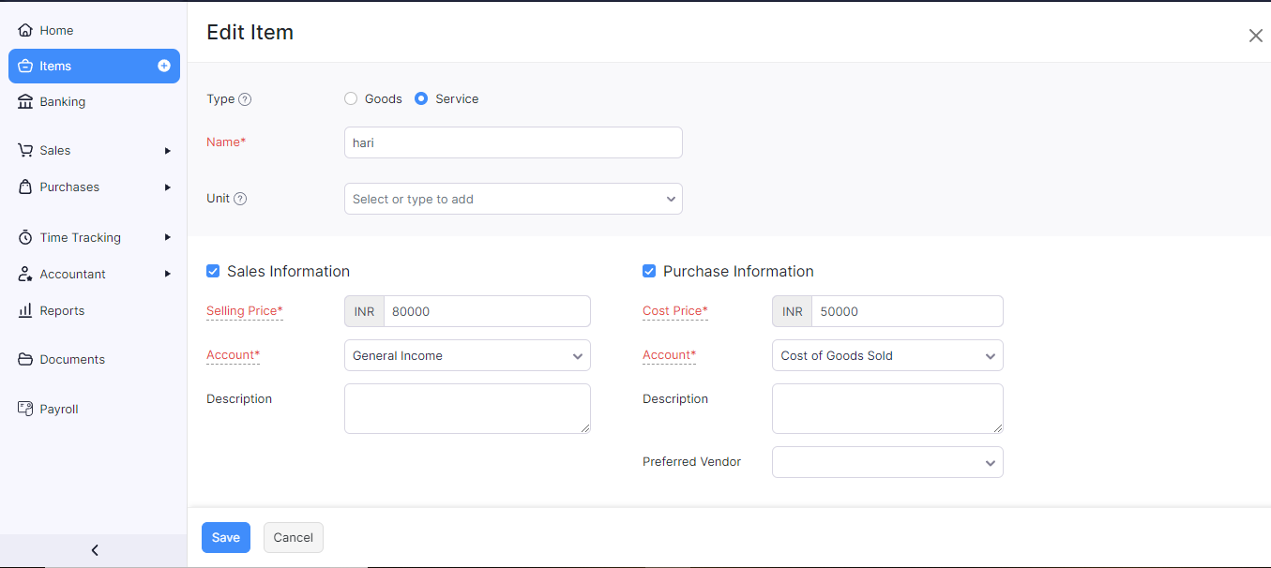
Item creation

Slide 8
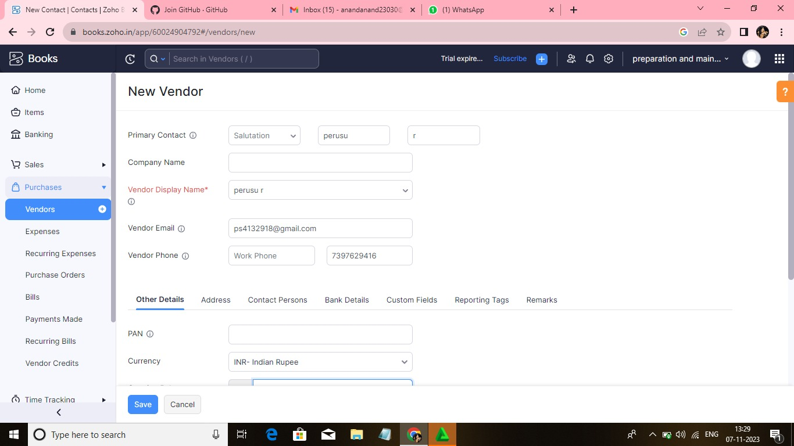
Vendor creation Now create Vendor in books from navigator panel Create New Vendor For example

Slide 9
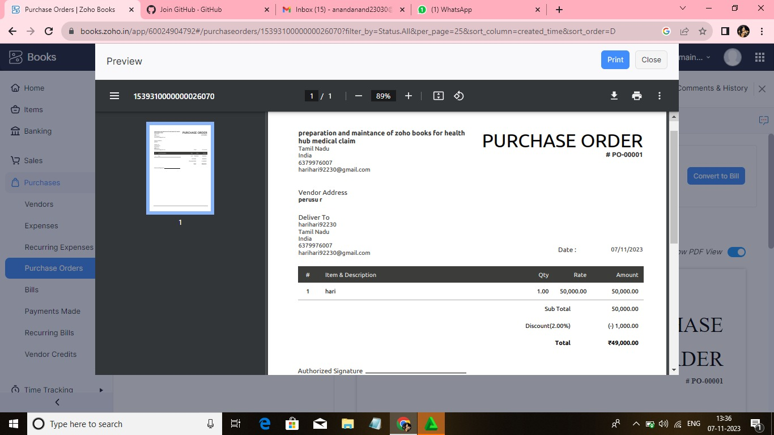
Purchase order We are creating new purchase order such as below

Slide 10
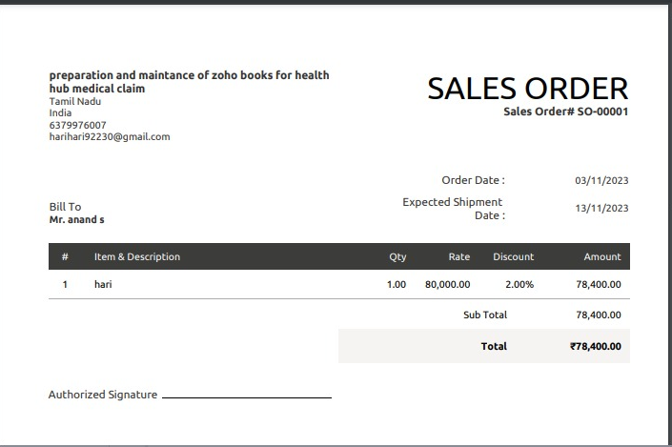
Sales order.

Slide 11
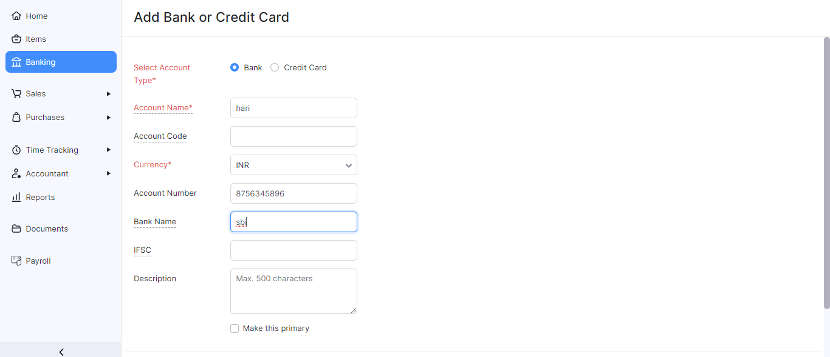
Payment to bank details spaghetti has opened an account with ICICI bank, to add the bank account And we have to select bank account manually and filled it

Slide 12
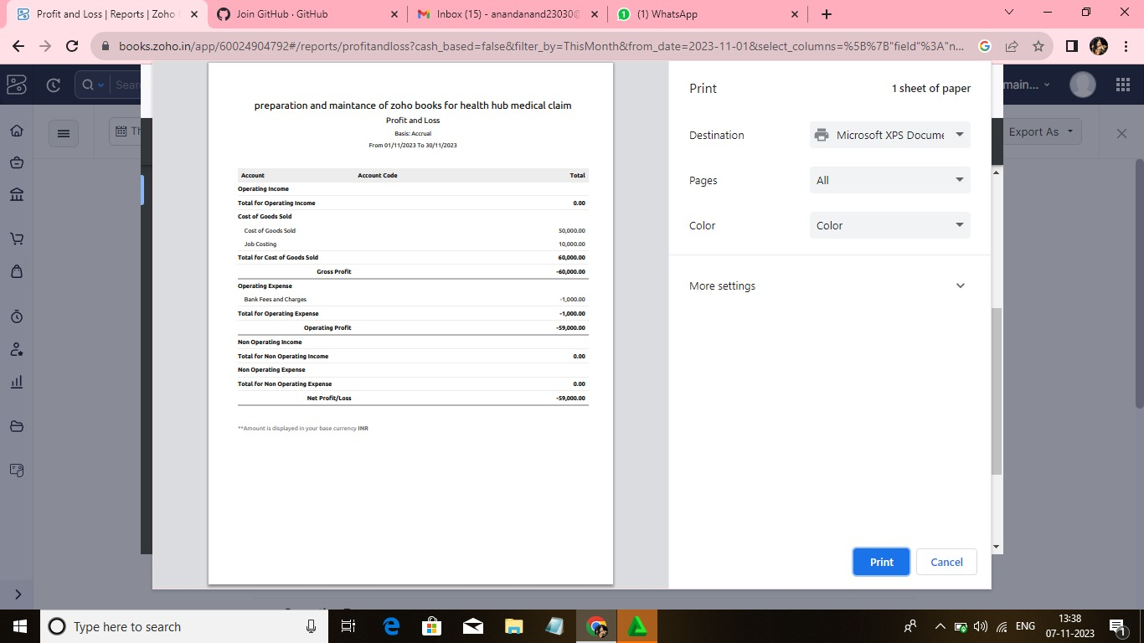

Slide 13
4 ADVANTAGE & DISADANTAGE: ADVANTAGE: Easy for Managing day to day activities. DISADVANTAGE: Missing New Version. 5 APPLICATION: This application used to maintain the company details and ledger accounts, profit and loss Account and Balance sheet of the dream homes realty.
6 CONCLUSION:
Preparation and maintance of zoho book for health hub medical claim provides a delightful culinary experience, combining exceptional flavors with impeccable service. With a diverse menu and a commitment to using fresh, high-quality ingredients, they consistently deliver a memorable dining experience. From casual gatherings to formal events, Fresh Bites Catering sets a standard of excellence that leaves clients and guests alike with a lasting impression. With their passion for food and dedication to customer satisfaction, Fresh Bites Catering is a top choice for any occasion.

Slide 14
The future scope of preparing maintenance and using Zoho Books for a health hub's medical claims management can be quite promising. Here are some potential benefits and areas of growth:
1. Streamlined Financial Management: Zoho Books can help streamline financial operations, making it easier to manage expenses, track income, and generate financial reports, which is crucial for medical claims management
.2. Cost Efficiency: By effectively managing expenses and revenue, a health hub can reduce overhead costs and optimize its financial resources, leading to cost efficiency.
3. Data Security: Zoho Books offers data security features that are essential for handling sensitive medical information and ensuring compliance with privacy regulations such as HIPAA.
4. Automation and Integration: Zoho Books can be integrated with other software and systems used in healthcare, allowing for automation of tasks such as invoice generation and payment processing.

